Slide 1
SOC 1105 Online: Introductory Sociology
Lecture 1a - Chapter 1: The Sociological Imagination

Slide 2
Using Your Sociological Imagination
A successful sociologist makes the familiar strange (or the strange familiar)
Watch the Chapter 1 Paradox video
Click on the Textbook link
Click on Videos and Animations
Click on Chapter 1 Paradox: A Successful Sociologist Makes the Familiar Strange

Slide 3

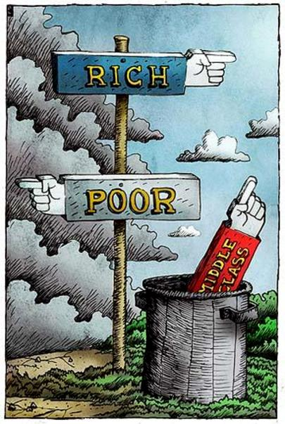


What is Sociology?
Scientific study of human behavior in society
Examples of sociological topics
Crime
Social inequality
Relations between men and women
Youth cultures

Slide 4
Many Influences on Human Behavior
Human behavior
Social context
Social structures
Individual experiences
Genetics
**Social structures and social context make up society**

Slide 5
What does “scientific study” mean?
What is science?
“Understanding natural phenomena through observation, generalization, and verification”
What can science not test?

Slide 6
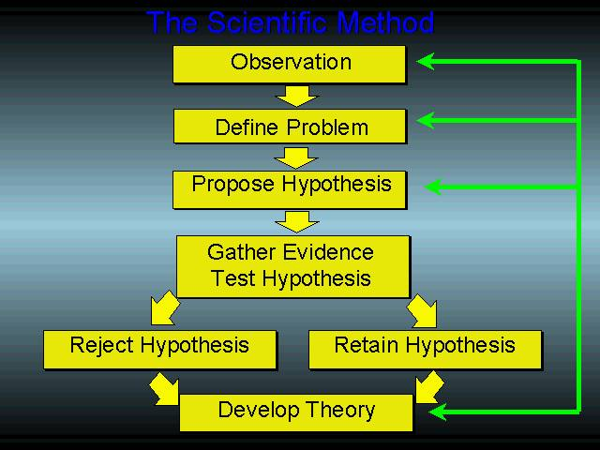

Slide 7

The Scientific Method
What is a Hypothesis?
Specific, testable statement predicting the outcome of a research study

Slide 8

The Scientific Method
What is a Theory?
Broad, rigorously tested statement explaining a series of phenomena or underlying causes

Slide 9
Hypothesis or Theory?
A society’s belief systems symbolize and reinforce a sense of belonging.
THEORY
People go to church because it gives them a sense of community
HYPOTHESIS
Social order is maintained by domination, with power in the hands of those with the greatest political, economic, or social resources.
THEORY
Rich people remain rich because they keep their money within their families
HYPOTHESIS

Slide 10
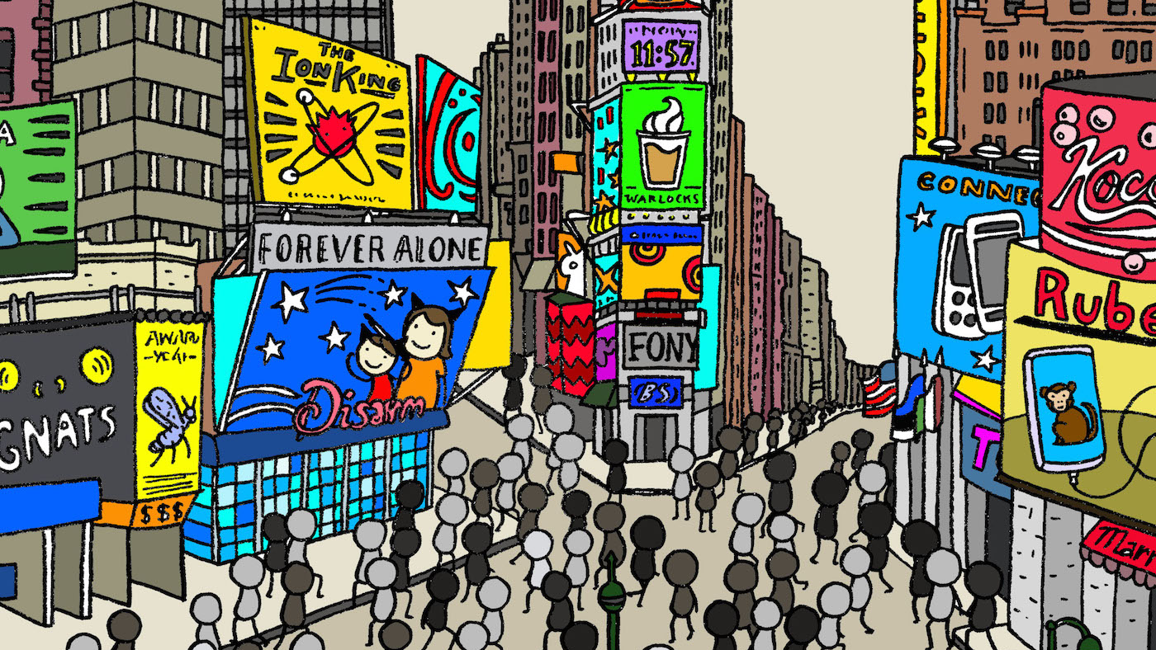
What is a society?
A collection of people living together in an ordered community

Slide 11



What is social context?
Behind the scenes patterns and processes that shape behavior
Social context is impacted by…
Historical influences
Globalization
Cultural diversity

Slide 12

Social Structure and Institutions
Social Institutions: complex group of interdependent positions with a specific and recognized social purpose
Social Structure: organized pattern of social relationships and social institutions that together constitute society

Slide 13
My Social Identity
Social identity is the way individuals define themselves in relation to groups of which they are a part (or in relation to groups of which they choose not to be a part).
Notes:
The different groups that you belong to help you tell others about your identity. You might say you are a daughter or son or a parent (your family is one of your groups). You might say you are a student (your school could be another group). You might also identify yourself by saying which groups you are not in (you’re not a college dropout, for instance).

Slide 14
Your Social Identity
Write down five social roles you fill - think about groups you belong to
Think about how these roles influence how you define yourself

Slide 15

The Sociological Perspective
Use your sociological imagination
C. Wright Mills (1959) – ability to see societal patterns that influence the individual as well as groups of individuals
Helps us question habits or customs that seem “natural”

Slide 16

Troubles vs. Issues: Individual vs. Society
I lost my job – personal trouble
What consequences might this have for me and my family?
How might this affect other parts of my life?
Unemployment – societal issue
What societal forces cause unemployment?
How does unemployment affect a community?
This is what sociologists study

Slide 17
Debunking Everyday Explanations
Sometimes tackle controversial issues, but also examine everyday issues
Often discover unsettling facts as sociologists look at issues in a new way – how society affects human behavior
Must establish critical distance

Slide 18

Establishing Critical Distance
Write down your reaction to the scenario on the next slide
How does it make you feel?
What do you think of the women in the scenario?
What do you think about the situation?

Slide 19
Death Without Weeping Nancy Scheper-Hughes
Brazil, a very Catholic country, has areas called shantytowns that consist of thrown together shacks in which extremely impoverished families live. The shantytowns emerged during a period when urban populations rose rapidly. Women in these shantytowns raise their children by themselves with little help or money. They also practice ‘selective neglect’ and/or ‘passive infanticide’. In other words, women allow children who are sickly to die without attempting to save them and in many cases limiting food and attention.

Slide 20
Establishing Critical Distance (continued)
Put your reaction aside
What social structures that might explain the scenario?
Consider…
Religion
Economics
Family structure
Write down an explanation for the scenario

